Slide 1
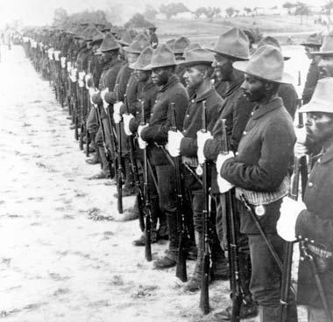
BUFFALO SOLDIERS

Slide 2
Introduction
Buffalo Soldiers commenced over b140 years ago.
In early 1450 brought a number of changes to the North American continent.
Most Native Americans faced European surveyors who would soon destroy and transform their world.
These explorers or rather surveyors started a trans- Atlantic slave.
They brought millions of slaves from Africa countries.
As a result, this gave birth to a new economic and social structure, where the individual's color determined whether they be a slave or not.
Throughout history, in every major warlike Indian war, Black Americans and Native Americans fought against each other.
This situation triumphed throughout the civil war.

Slide 3
TheCont.
Some communities such as the Cherokees fought the south and others like the Seminoles helped the North (Mason, 2019).
On another hand, the Africans in bondage brought over on slave vessels decades of years before liberty time arrived.
Many slaves ran away when the Northern troops arrived in the South.
They were releases or emancipated in order to fight for their freedom.

Slide 4
Black Americans a tough look at soldierly services which provided;
Education
Medical service
Pension
Shelter
Steady pay

Slide 5
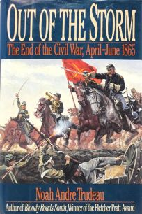
End of Civil War in 1865
In 1865, when the civil war ended.
About 186, 000 freedmen and former slaves had worked for the United States Colored Troops.
Which is abbreviated as USCT and 10 of the total Union Strength.
While about 200, 000 slaves served as military support, hospital engineers, and so on.
Another 30, 000 served in the merchant navy in various departments

Slide 6
One year after the Civil war ended, 1866
This was reconstruction era.
13th Amendment was enacted where the slave trade was abolished.
Congress also saw the need to modify and reorganize the structure of the army.
They focused on structuring the army merits of Black American soldiers.
Two segregated black cavalry regiments and four black infantry were authorized.
This included former slaves, African civil war troops, and freedmen.
Also, the latter was made as to the 9th and 10th US cavalry.
This was intended to be the most adorned of all the United States Military Battalions.
Therefore instigated the Legend of the Buffalo Soldiers.
This was the first Black Americans to serve during this period of peace.

Slide 7
How the Buffalo Soldiers Got Their Name
The name emerged with the Cheyenne soldiers or warriors in early 1867.
During this period, Black American soldiers were courageous and ferocious in war, even when they were less in numbers.
As a sign of honor and respect, Cheyenne nicknamed the hard fighting black soldiers in blue uniform Buffalo soldiers.
The nickname may also be attributed to their hair which looked like of the revered bison (Juárez, 2019).
According to Indians, Buffalo was a sign of courage and strength.
This is because buffalo was a sacred and dangerous wild animal to the Indians.
The name became so famous and it was proudly adopted as it was a highly respected American legacy.

Slide 8
The Distinction wars fought by Buffalo Soldiers
In the Cheyenne war which started in 1867 and ended in 1869
In the Red River War which occurred between 1874- 1875
In the Ute War which took place in 1879
In the Apache wars which started in 1875 and ended in 1886
In the Sioux wat which started in 1890 and ended in 1891
During the western campaign, more than 13 congressional honor medals were issued to Buffalo soldiers (Hoverson, 2015).

Slide 9
The Brave10th Calvary Congressional Honor medals
Sergeant William McBryar
Private Fitz Lee
Sergeant Major Edward L. Baker
Private Dennis Bell
Second Lieutenant Powhattan H. Clarke
Sergeant William Tompkins
Captain Louis H. Carpenter
Private George H. Wanton

Slide 10
The services for Buffalo Soldiers
Discovered and established maps of unexplored wilderness..
Helped ruling people and civil authorities control mobs.
Renovated and built dozens of camps and posts.
Built telegraph lines, patrols, and roads.
Chased cattle thieves, outlaws, as well as Mexican revolutionaries who settled along the borders.
They also escorted wagon trains
Moreover, they safeguarded settlers
Provide security to workers building the roads connecting continents.

Slide 11
Challenges faced by the Buffalo Soldiers
Poor diets and insufficient foods
Jurisdiction
Given weak and broken horses
Hostile working environments
Harsh punishments
Use of hand me down weapons, uniforms, and Equipment

Slide 12
References
Hoverson, M. (2015). Buffalo Soldiers at Kīlauea, 1915–1917. Hawaiian Journal of History, 49(1), 73-90.
Juárez, M. (2019). From Buffalo Soldiers to Redlined Communities: African American Community Building in El Paso's Lincoln Park Neighborhood. American Studies, 58(3), 107-127.
Mason, K. S. (2019). Buffalo Soldiers as Guardians of the Parks: African‐American Troops in the California National Parks in the Early Twentieth Century. The Historian, 81(1), 84-98.

